Slide 1
CLAS 220 Introduction to Classical Mythology
Homer, Odyssey 1-6

Slide 2
Quiz Question
What is the name of Odysseus’ son?
Telegonus
Telemachus
Antilochus
Arsinoe

Slide 3
Quiz Question
2. At the beginning of the Odyssey, how long has Odysseus been away from home?
Six months
Ten years
Seventeen years
Twenty years

Slide 4
The Epic Cycle
Trojan War – the Epic Cycle
The Cypria
The Iliad
The Aethiopis
The Little Iliad
The Ilioupersis (The Sack of Troy)
The Nostoi (The Returns Home)
The Odyssey
The Telegony

Slide 5
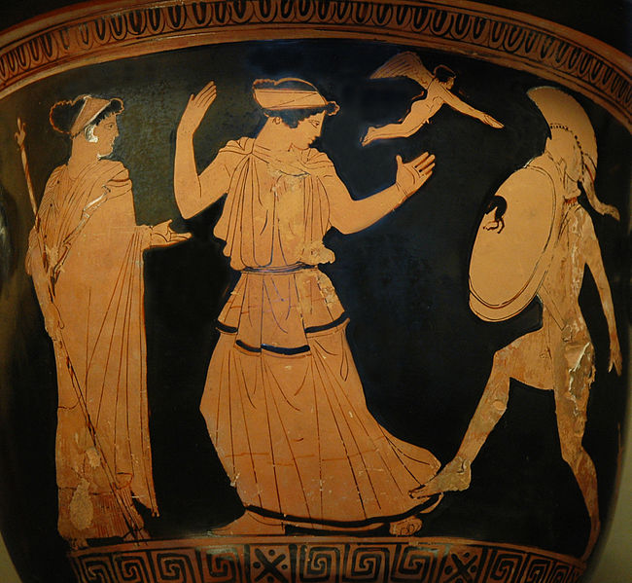
Nostoi
Remember that nostos is a homecoming
the Nostoi
Diomedes and Nestor get home safely.
Menelaos gets sidetracked to Egypt, but eventually returns.
Neoptolemos (Achilles’ son) returns by land.
Agamemnon gets home, but is murdered by his wife Clytemnestra and her lover, Agamemnon’s cousin Aegisthus.
Note that being home is sometimes just as hard as getting home

Slide 6
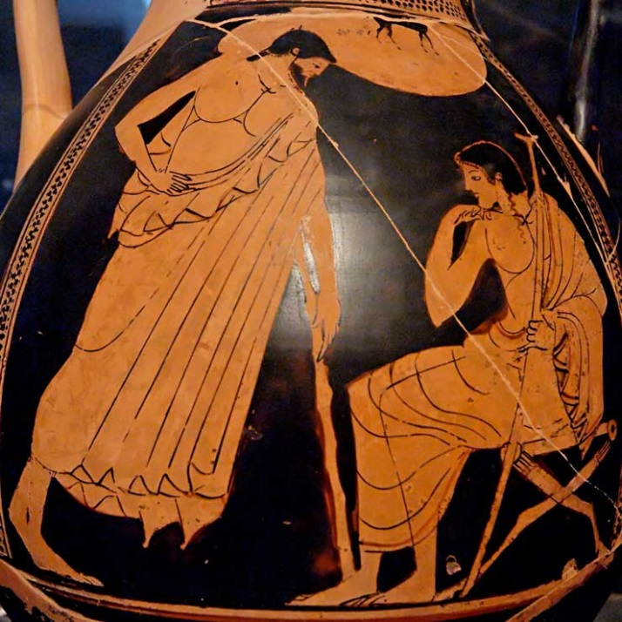
Odyssey
The Odyssey is extreme nostos.
The last, longest, (ten years) most difficult and most famous of all the homecomings, that of Odysseus
Odysseus is an anti-Akhilleus
Akhilleus is the hero of biê, or strength
Odysseus is the hero of mêtis, or cunning
Akhilleus must choose between kleos and nostos.
For Odysseus, his kleos IS his nostos.

Slide 7
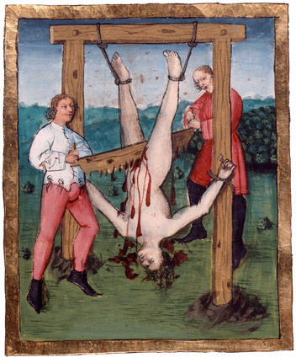
Telegony
Stay tuned!

Slide 8
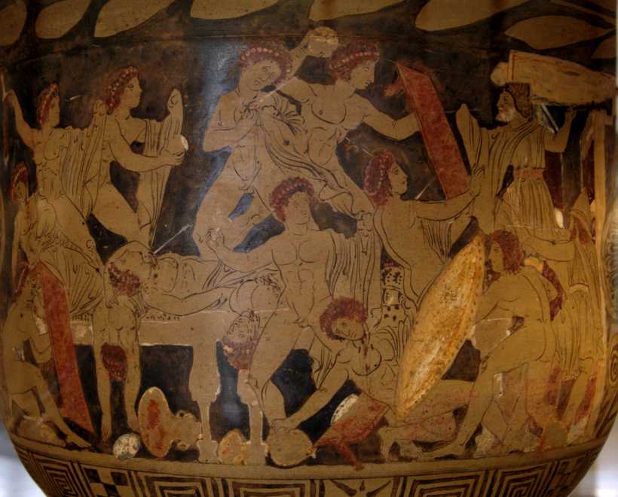
The Epic Cycle (condensed)
As the Homeric tradition evolves, the minor poems disappear, and we’re left with the Iliad and Odyssey
Previously, we saw how the Iliad incorporates elements of the earlier sections of the Trojan War, and foreshadowed the death of Akhilleus
The Odyssey will look back on the death of Akhilleus and the fall of Troy, and will also incorporate the nostoi of the other Greek heroes

Slide 9
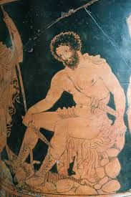
The Muse Invoked
Sing in me, Muse, and through me tell the story
Of that man skilled in all ways of contending, [polutropos]
The wanderer, harried for years on end,
After he plundered the stronghold
On the proud heights of Troy. He saw the townlands
And learned the minds of many distant men,
And weathered many bitter nights and days
In his deep heart at sea, while he fought only
To save his life, to bring his shipmates home.
Odyssey 1.1-9

Slide 10
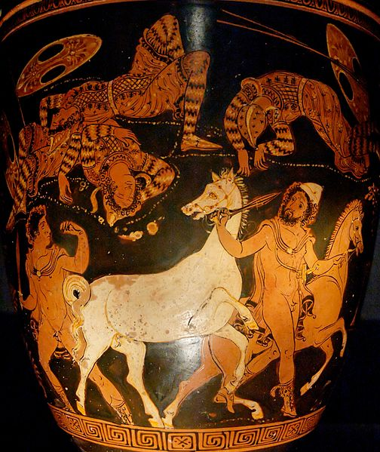
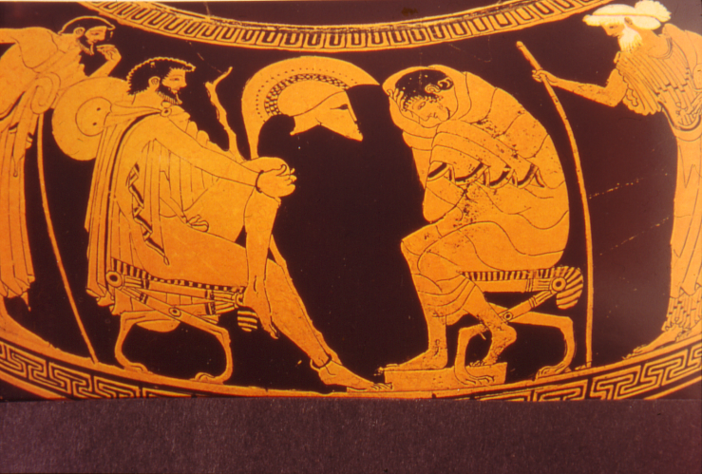
Odysseus in the Iliad
Not the most prominent of heroes
Key episodes: the embassy, the night raid.
(Remember: The Iliad as the poem of Akhilleus and of biê (strength)
the Odyssey is the poem of Odysseus and of mêtis (cunning)

Slide 11
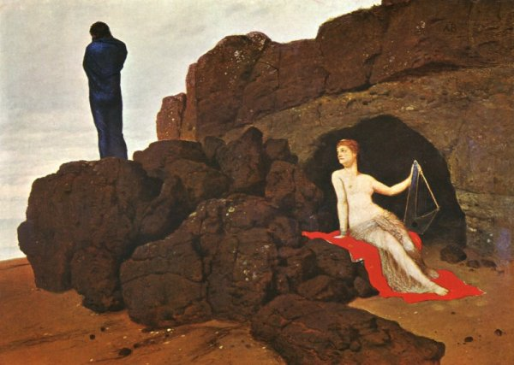
The story so far…
Begin when all the rest who left behind them
Headlong death in battle or at sea
Had long ago returned, while he alone still hungered
For home and wife. Her ladyship Kalypso
Clung to him in her sea-hollowed caves –
A nymph, immortal and most beautiful,
Who craved him for her own.
1.17-25

Slide 12
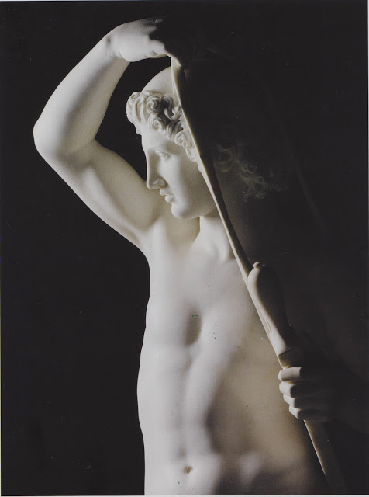
The Telemachy
Books 1-4 are not about Odysseus
Instead, they are the story of Odysseus’ son, Telemakhos, who goes in search of his father.
Telemakhos is about 20 years old, and his father has been absent for 20 years
His mother, Penelope, has been waiting, trying to keep Odysseus’ home together, while 108 of their neighbors try to marry her.
Athena inspires Telemakhos to go in search of his father (to win kleos of his own)

Slide 13
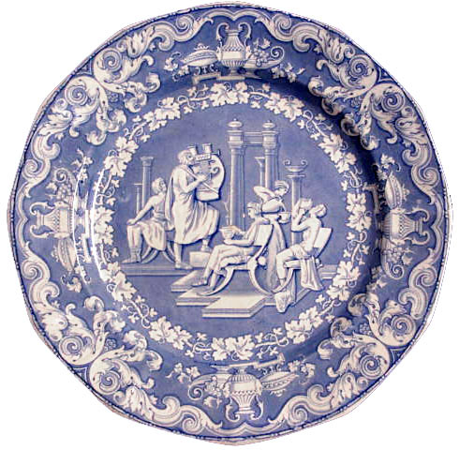
“That Bitter Song”
The famous minstrel still sang on before them,
And they sat still and listened, while he sang
That bitter song, the Homecoming (Nostoi) of the Akhaians –
How by Athena’s will they fared from Troy;
And in her high room careful Penelope,
Ikarios’ daughter, heeded the holy song….
And through her tears spoke to the noble minstrel:
“Phemios, other spells you know, high deeds
Of gods and heroes, as the poets tell them;
Let these men hear some other; let them sit
Silent and drink their wine. But sing no more
This bitter tale that wears my heart away.
It opens in me again the wound of longing
For one incomparable, ever in my mind –
His fame all Hellas knows, and midland Argos.”
1.376-395

Slide 14
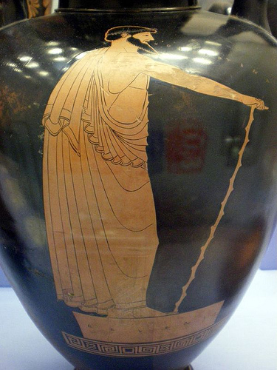
Telemachus’ response
“Mother, why do you grudge our own dear minstrel
Joy of song, wherever his thought may lead?
Poets are not to blame, but Zeus who gives
What fate he pleases to adventurous men.
Here is no reason for reproof: to sing
The news of the Danaans! Men like best
A song that rings like morning on the ear.
But you must nerve yourself and try to listen.
Odysseus was not the only one at Troy
Never to know the day of his homecoming.
Others, how many others, lost their lives!”
The lady gazed in wonder and withdrew,
Her son’s clear wisdom echoing in her mind…
1.397-409

Slide 15
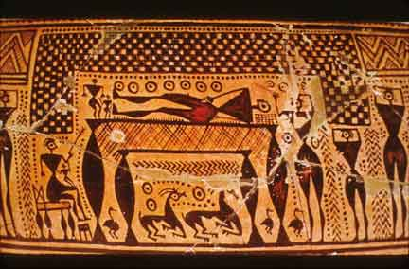
The ear of the beholder
In other words, what the suitors (and Telemakhos) experiences as kleos, Penelope experiences as penthos
Penthos: grief, lament, song of lament

Slide 16
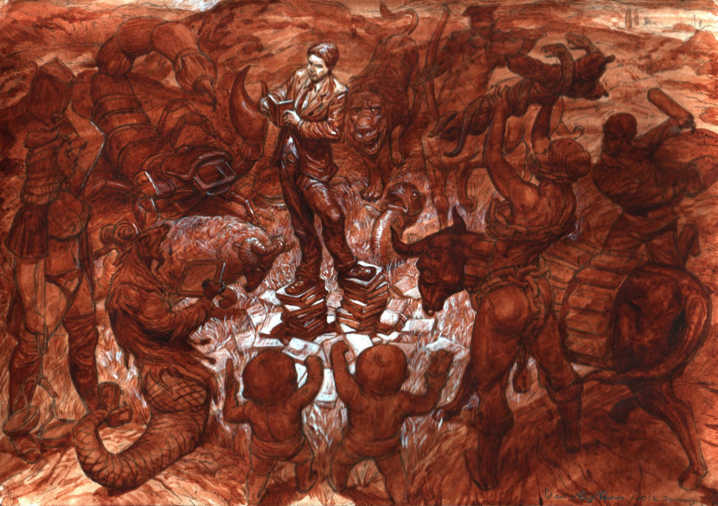
Assembly on Ithaka
Telemakhos:
“My distinguished father is lost,
Who ruled among you once, mild as a father,
And there is now this greater evil still:
My home and all I have are being ruined.
Mother wanted no suitors, but like a pack
They came...”
And in hot anger now he threw the staff to the ground,
His eyes grown bright with tears. A wave of sympathy
Ran through the crowd, all hushed, and no one there
Had the audacity to answer harshly…
2.49-89

Slide 17
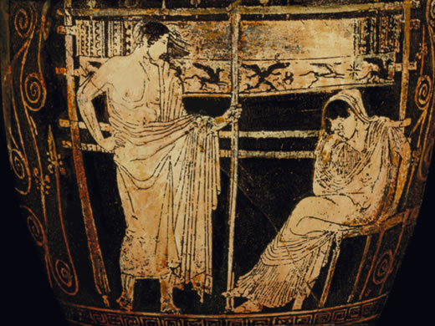
Assembly on Ithaka
… except Antinoos, who said,
“What high and mighty
Talk, Telemakhos! No holding you!
You want to shame us, and humiliate us,
But you should know the suitors are not to blame –
It is your own dear, incomparably cunning mother.
For three years now – and it will soon be four–
She has been breaking the hearts of the Akhaians…
She had her great loom standing in the hall
And the fine warp of some vast fabric on it….
‘It is a shroud I weave for Lord Laertes…’
So every day she wove on the great loom –
But every night by torchlight she unwove it…
2.90-102

Slide 18
Quiz Question
3. Whom does Telemachus meet on his journey?
Helen
Nestor
Menelaus
All of the above

Slide 19
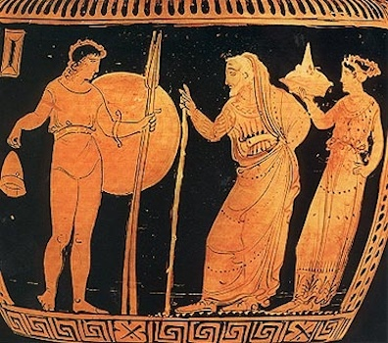
Telemachus at Pylos
“Athena went on quickly, and he followed her
To where the men of Pylos had their altars.
Nestor appeared enthroned among his sons,
While friends around them skewered the red beef
Or held it scorching. When they saw the strangers
A hail went up, and all that crowd came forward
Calling out invitations to the feast…
Meanwhile the spits were taken off the fire,
Portions of crisp meat for all. They feasted,
And when they had eaten and drunk their fill, at last
They heard from Nestor, prince of charioteers:
“… who are you, strangers? Where are you sailing from,
And where to, down the highways of salt water?”
3.36-79

Slide 20
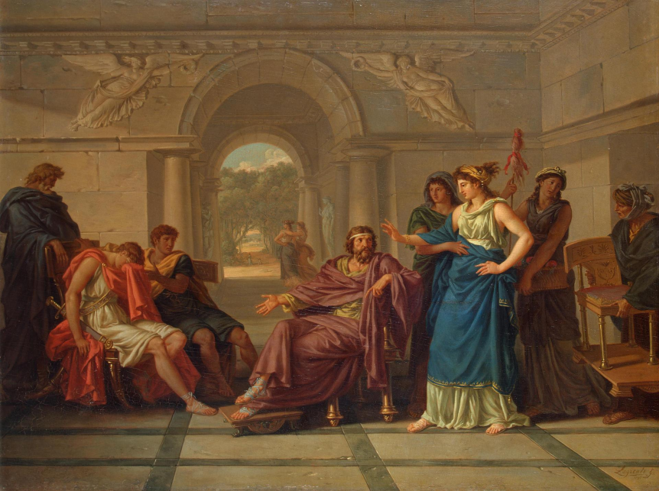
Menelaus and Helen Recognize Telemachus
And the red-haired captain, Menelaos, answered:
“My dear, I see the likeness as well as you do.
Odysseus’ hands and feet were like this boy’s;
His head, and hair, and the glinting of his eyes.
Not only that, but when I spoke, just now,
Of Odysseus’ years of toil on my behalf
And all he had to endure – the boy broke down
And wept into his cloak.
4.159-165

Slide 21
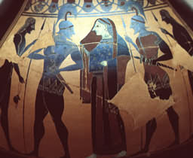
Helen Drugs Everyone
But now it entered Helen’s mind
To drop into the wine that they were drinking
An anodyne, mild magic of forgetfulness.
Whoever drank this mixture in the wine bowl
Would be incapable of tears that day –
Though he should lose mother and father both,
or see, with his own eyes, a son or brother
Mauled by weapons at his own gate.
4. 235-42
NB: Her drug is called nepenthe, which means no penthos.
With the help of nepenthe, the stories of Helen’s and
Menelaus’ past become kleos for them.

Slide 22

Menelaus wrestles with Proteus

Slide 23
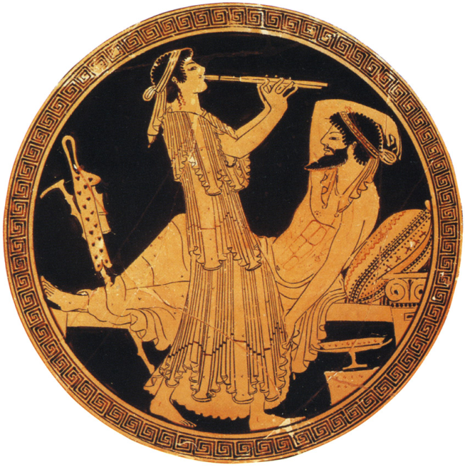
One left at sea
“Laertes’ son, whose home is Ithaka.
I saw him weeping, weeping on an island.
The nymph Kalypso has him, in her hall.
No means of faring home are left him now;
No ship with oars, and no ship’s company
To pull him on the broad back of the sea.
4.591-596

Slide 24
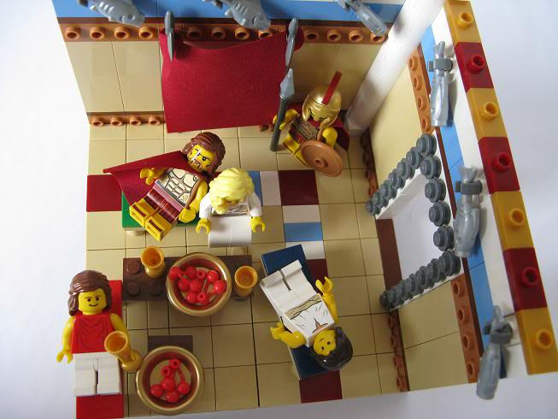
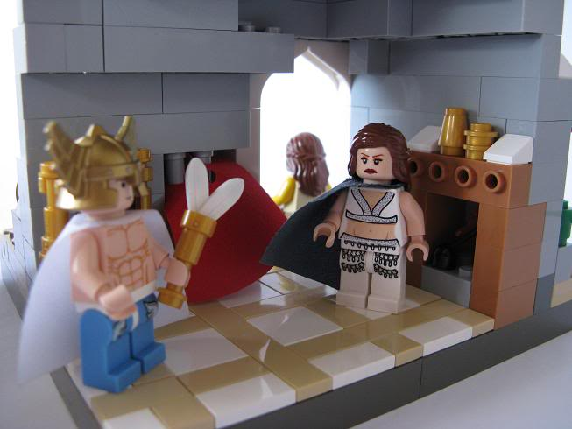
Meanwhile….
we leave Telemakhos behind in Sparta,
with the suitors in Ithaka plotting to ambush him, and Penelope receiving a dream saying he's OK.
we now turn to the story of Odysseus, still stranded on the island of Kalypso

Slide 25
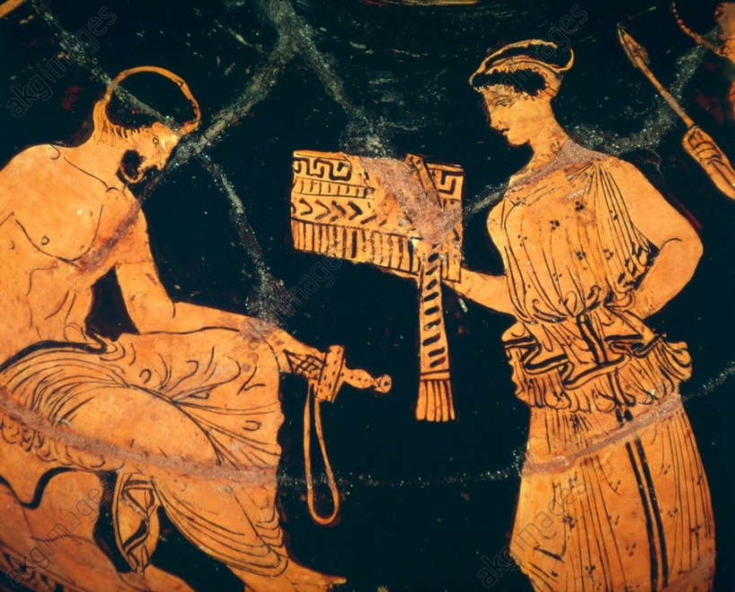
A divine double standard
Kalypso:
“Oh you vile gods, in jealousy supernal!
You hate it when we choose to lie with men –
Immortal flesh by some dear mortal side.
So radiant Dawn once took to bed Orion
Until you easeful gods grew peevish at it,
And holy Artemis, Artemis throned in gold,
Hunted him down in Delos with her arrows.
5.124-130

Slide 26
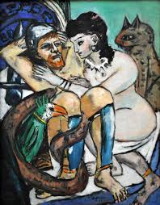
We meet Odysseus
Odysseus
In his stone seat to seaward – tear on tear
Brimming his eyes. The sweet days of his life time
Were running out in anguish over his exile,
For long ago the nymph had ceased to please.
Though he fought shy of her and her desire,
He lay with her each night, for she compelled him.
But when day came he sat on the rocky shore
And broke his own heart groaning, with eyes wet
Scanning the bare horizon of the sea.
5. 157-166

Slide 27
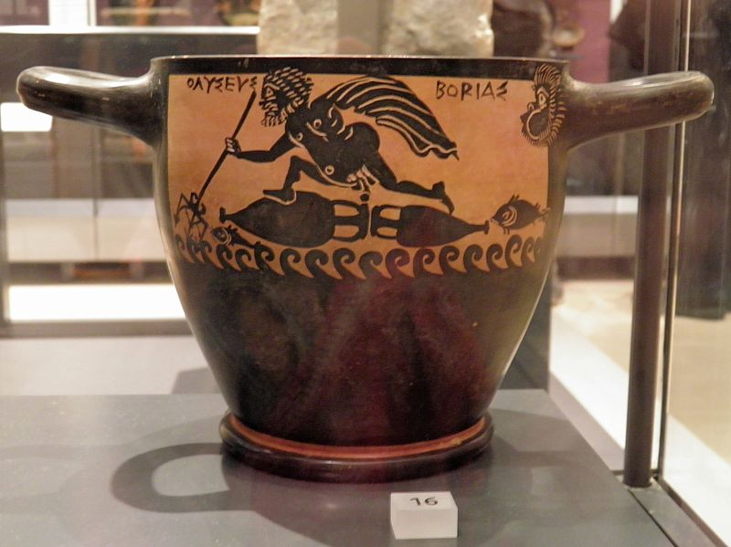
Storm at sea
A great wave drove at him with toppling crest
Spinning him round in one tremendous blow,
And he went plunging overboard, the oar-haft
Wrenched from his grip. …
But Ino saw him, Ino, Kadmos’ daughter,
Slim-legged, lovely, once an earthling girl,
Now in the seas a nereid, Leukothea….
“Here: make my veil your sash; it is not mortal;
You cannot, now, be drowned or suffer harm.
5. 324-360

Slide 28
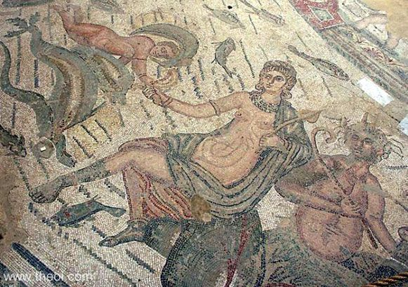
Storm at Sea
NOSTOS: Literally return home,
Mystically also return to life
Ino: sister of Semele,
in the royal house of Thebes
Raises Dionysus after his mother's death
Punished by Hera -- her husband Athamas goes mad
She escapes into the sea,
Becomes the sea-goddess Leukothea
(The White Goddess)

Slide 29
Quiz Question
4. Who rescues Odysseus after he survives this storm at sea?
Nausicaa
Calypso
Circe
Penelope

Slide 30

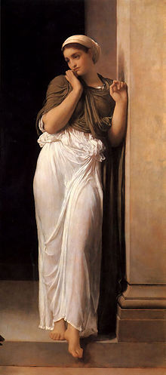
Nausicaa
In this form grey-eyed Athena said to her:
“How so remiss, and yet they mother’s daughter?
Leaving thy clothes uncared for, Nausikaa,
When soon thou must have store of marriage linen,
And put thy minstrelsy in marriage dress!...
Go beg thy sovereign father, even at dawn,
To have the mule cart and the mules brought round
To take thy body-linen, gowns and mantles.
6.30-44

Slide 31
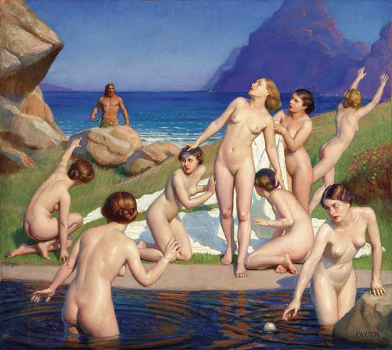
Maidens bathing
All being drubbed, all blemish rinsed away,
They spread them, piece by piece, along the beach
Whose pebbles had been laundered by the sea;
Then took a dip themselves, and, all anointed
With golden oil, ate lunch beside the river
While the bright burning sun dried out their linen.
Princess and maids delighted in that feast;
Then, putting off their veils,
They ran and passed a ball to a rhythmic beat,
Nausikaa flashing first with her white arms.
6.100-109

Slide 32
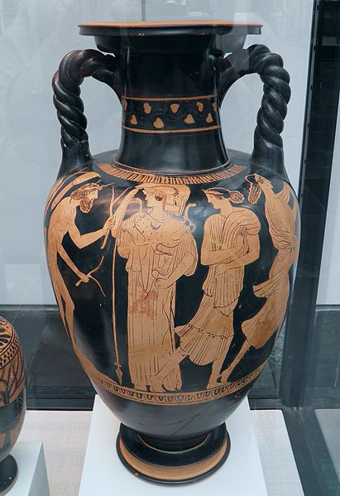
Odysseus reveals himself
He pushed aside the bushes, breaking off
With his great hand a single branch of olive,
Whose leaves might shield him in his nakedness;
So came out rustling, like a mountain lion,
Rain-drenched, wind-buffeted, but in his might at ease,
With burning eyes – who prowls among the herds
Or flocks, or after game, his hungry belly
Taking him near stout homesteads for his prey.
Odysseus had this look, in his rough skin
Advancing on the girls with pretty braids;
And he was driven on by hunger, too.
Streaked with brine, and swollen, he terrified them,
So that they fled, this way and that.
6. 136-149

Slide 33
Quiz Question:
5. Who holds Odysseus captive for seven years?
Penelope
Helen
Calypso
Clytemnestra

